Slide 1
Email Delivery
Lecturer: Ngo Huy Bien
Software Engineering Department
Faculty of Information Technology
VNUHCM - University of Science
Ho Chi Minh City, Vietnam
nhbien@fit.hcmus.edu.vn

Slide 2

Objectives

Slide 3

Contents

Slide 4

References

Slide 5
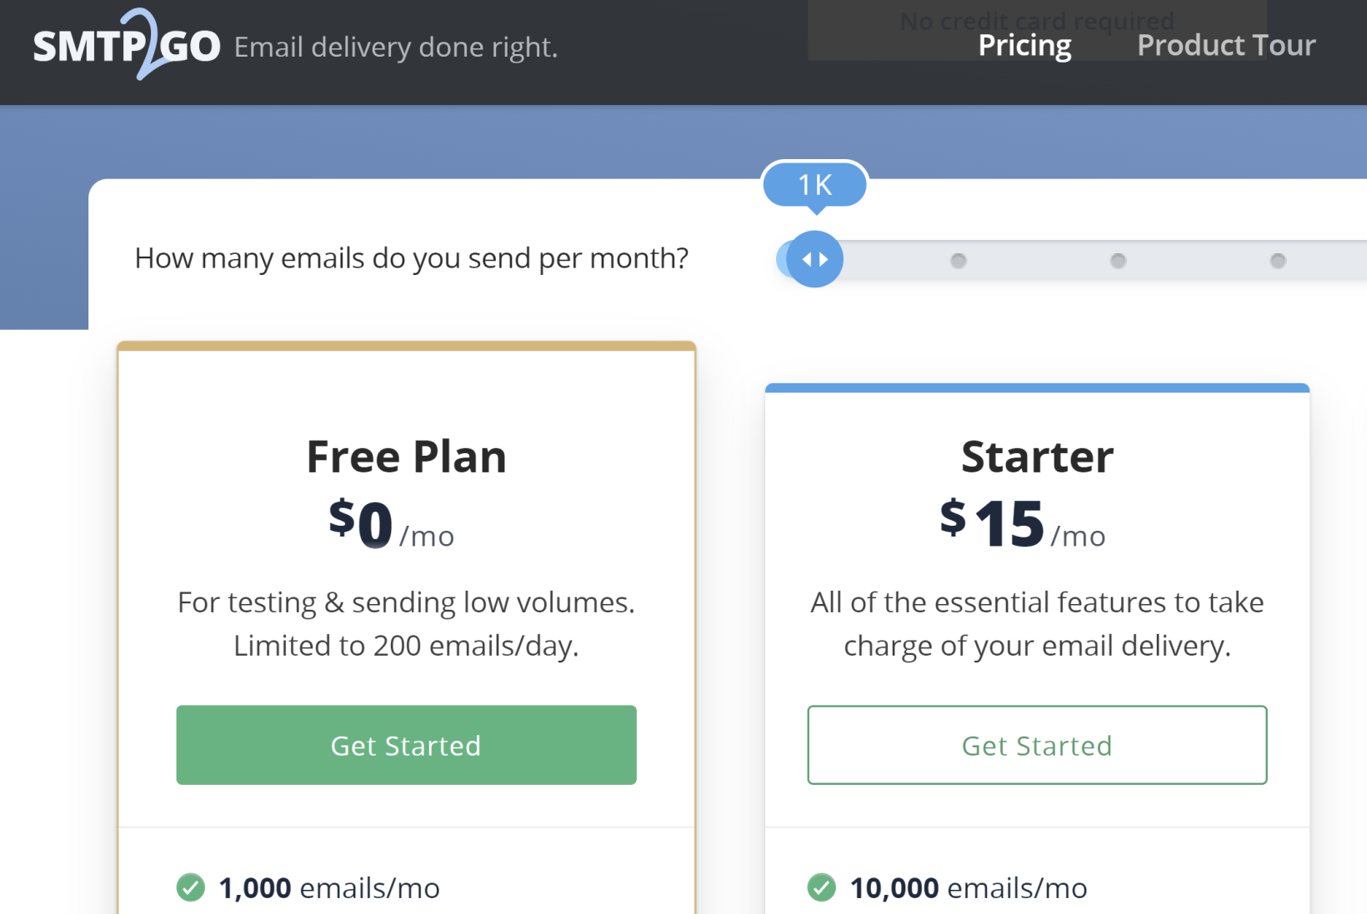
1. Create a SMTP2GO Account
https://www.smtp2go.com/pricing/

Slide 6
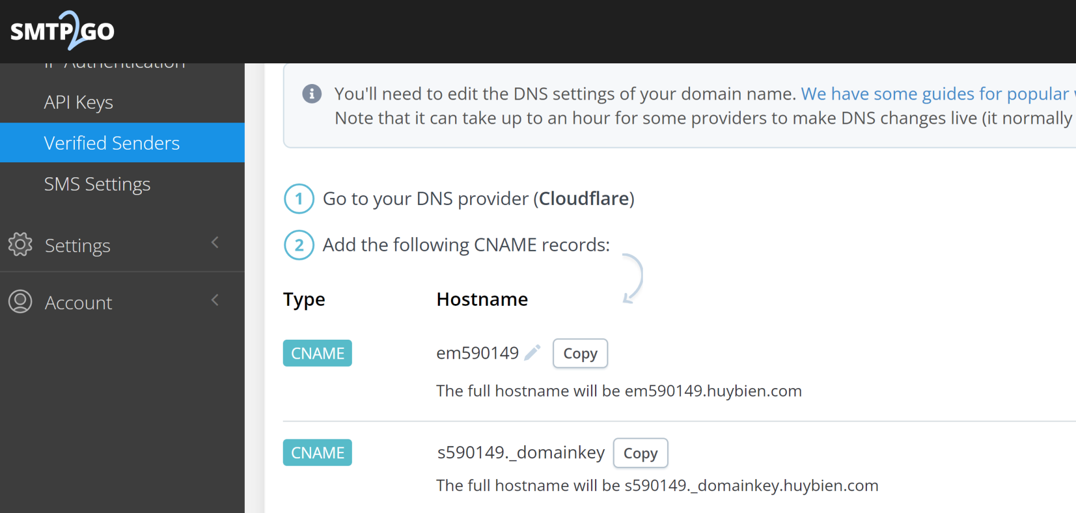
2. Verify Sender

Slide 7
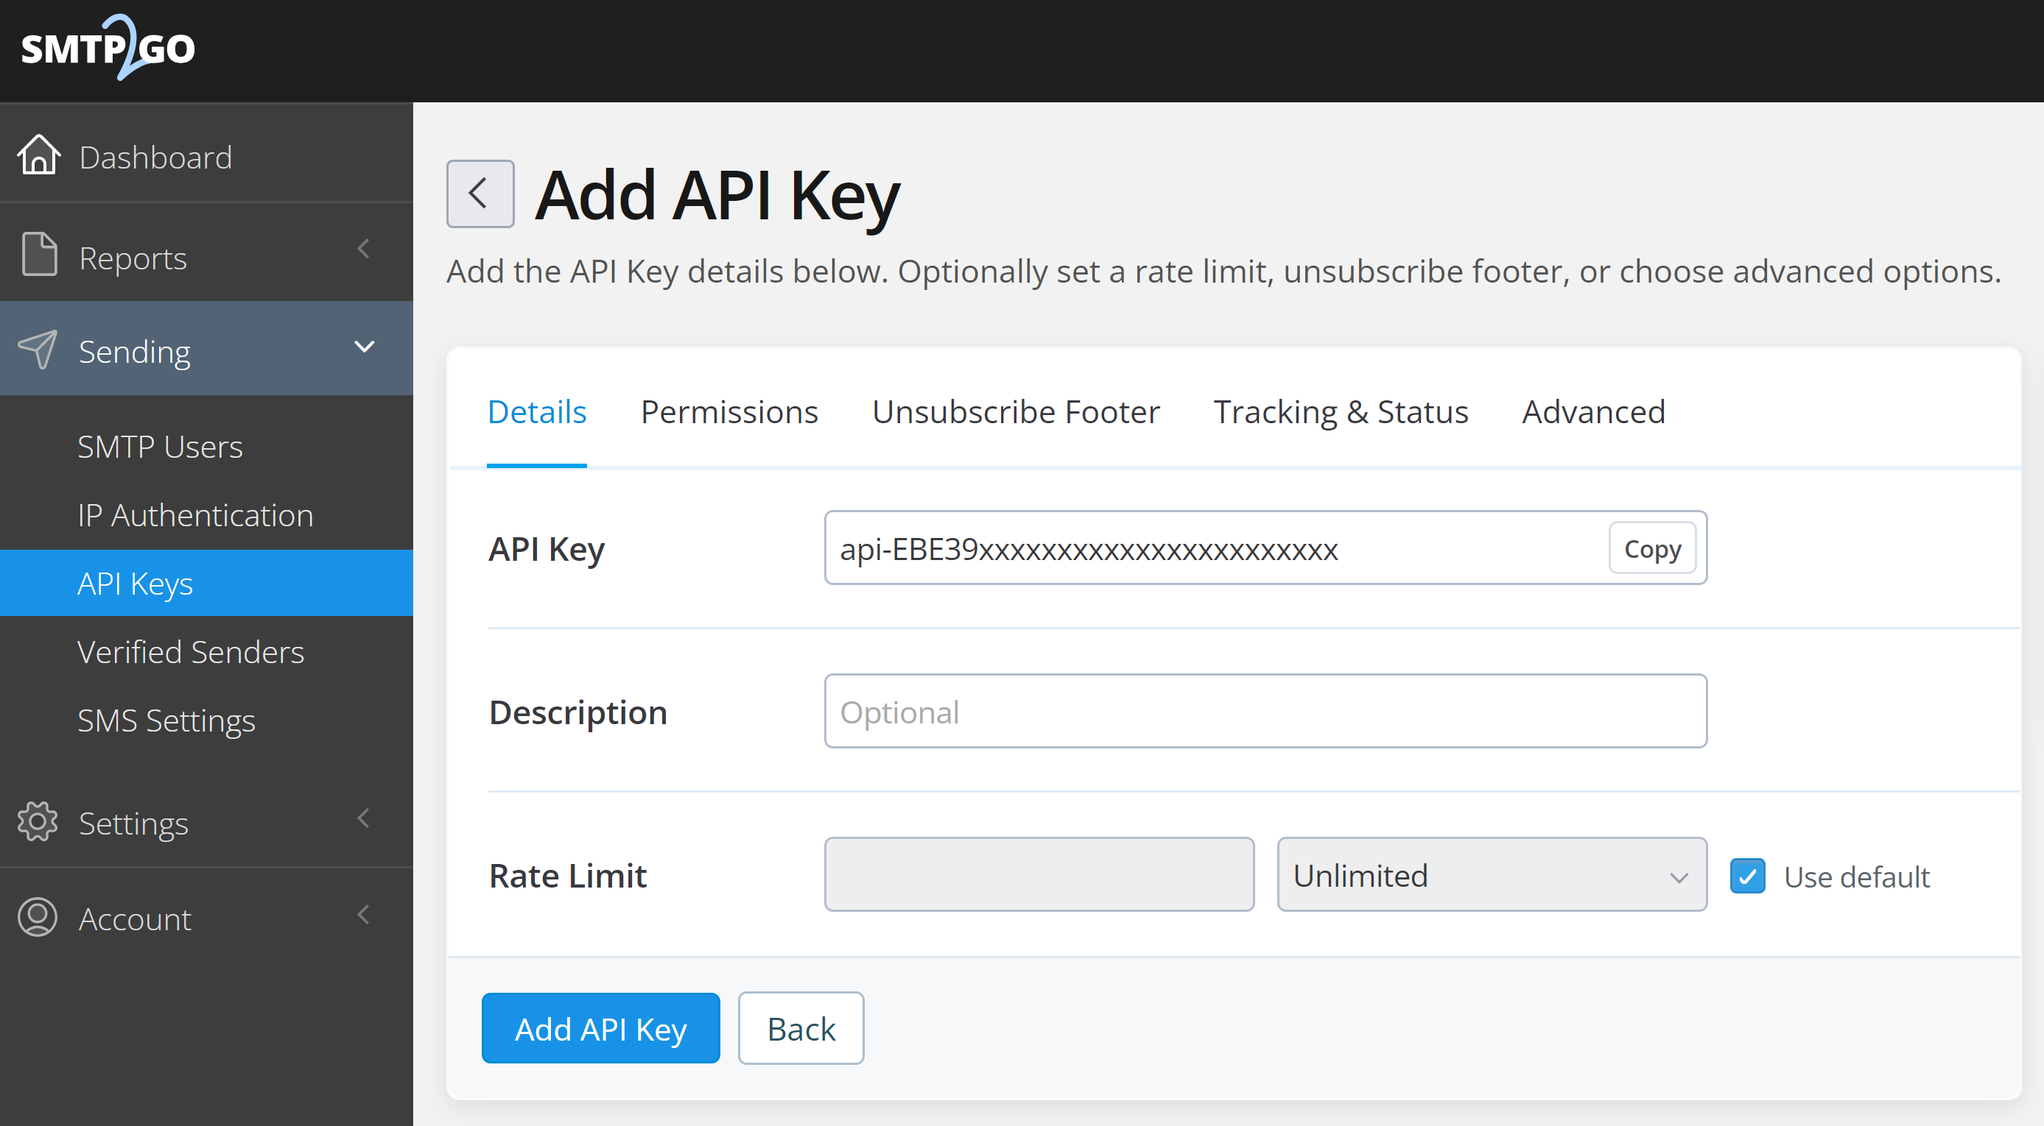
3. Create API Key

Slide 8
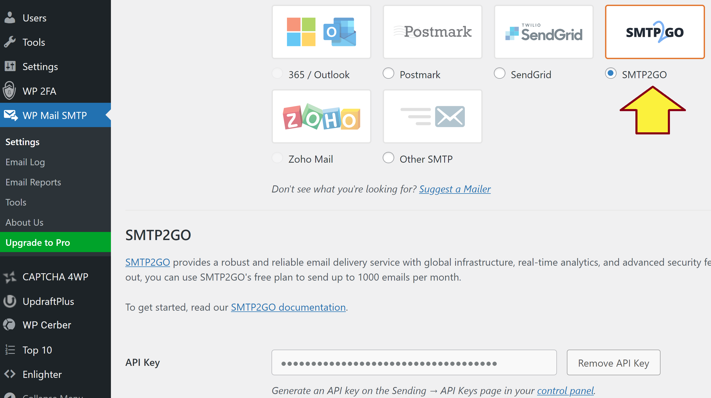
4. Install and Configure WP Mail SMTP

Slide 9


Slide 10
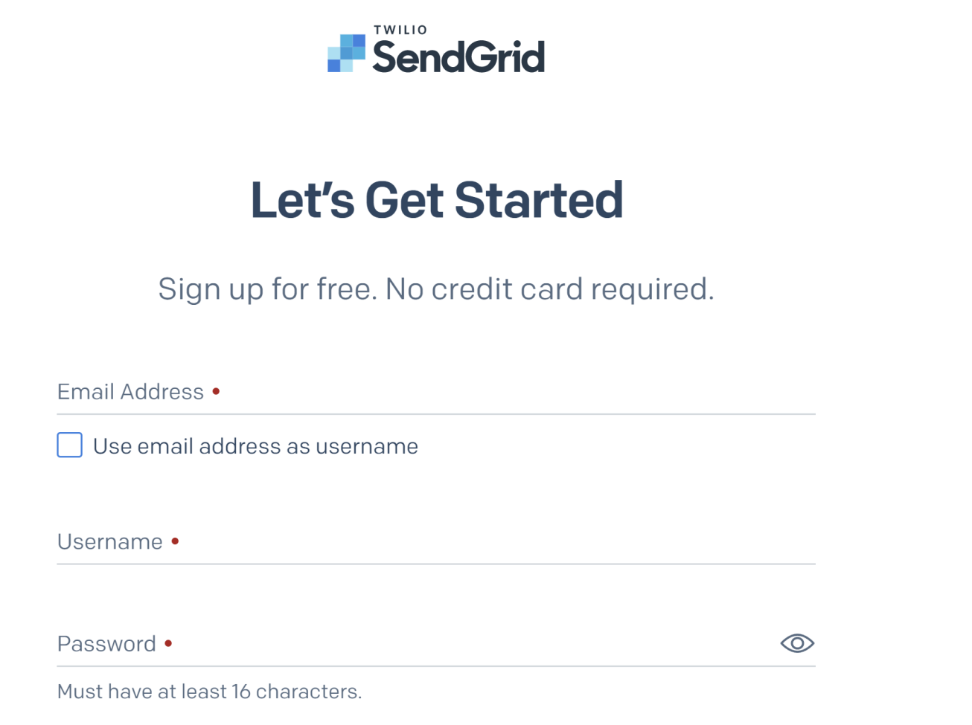
1. Create a SendGrid Account
https://signup.sendgrid.com/

Slide 11
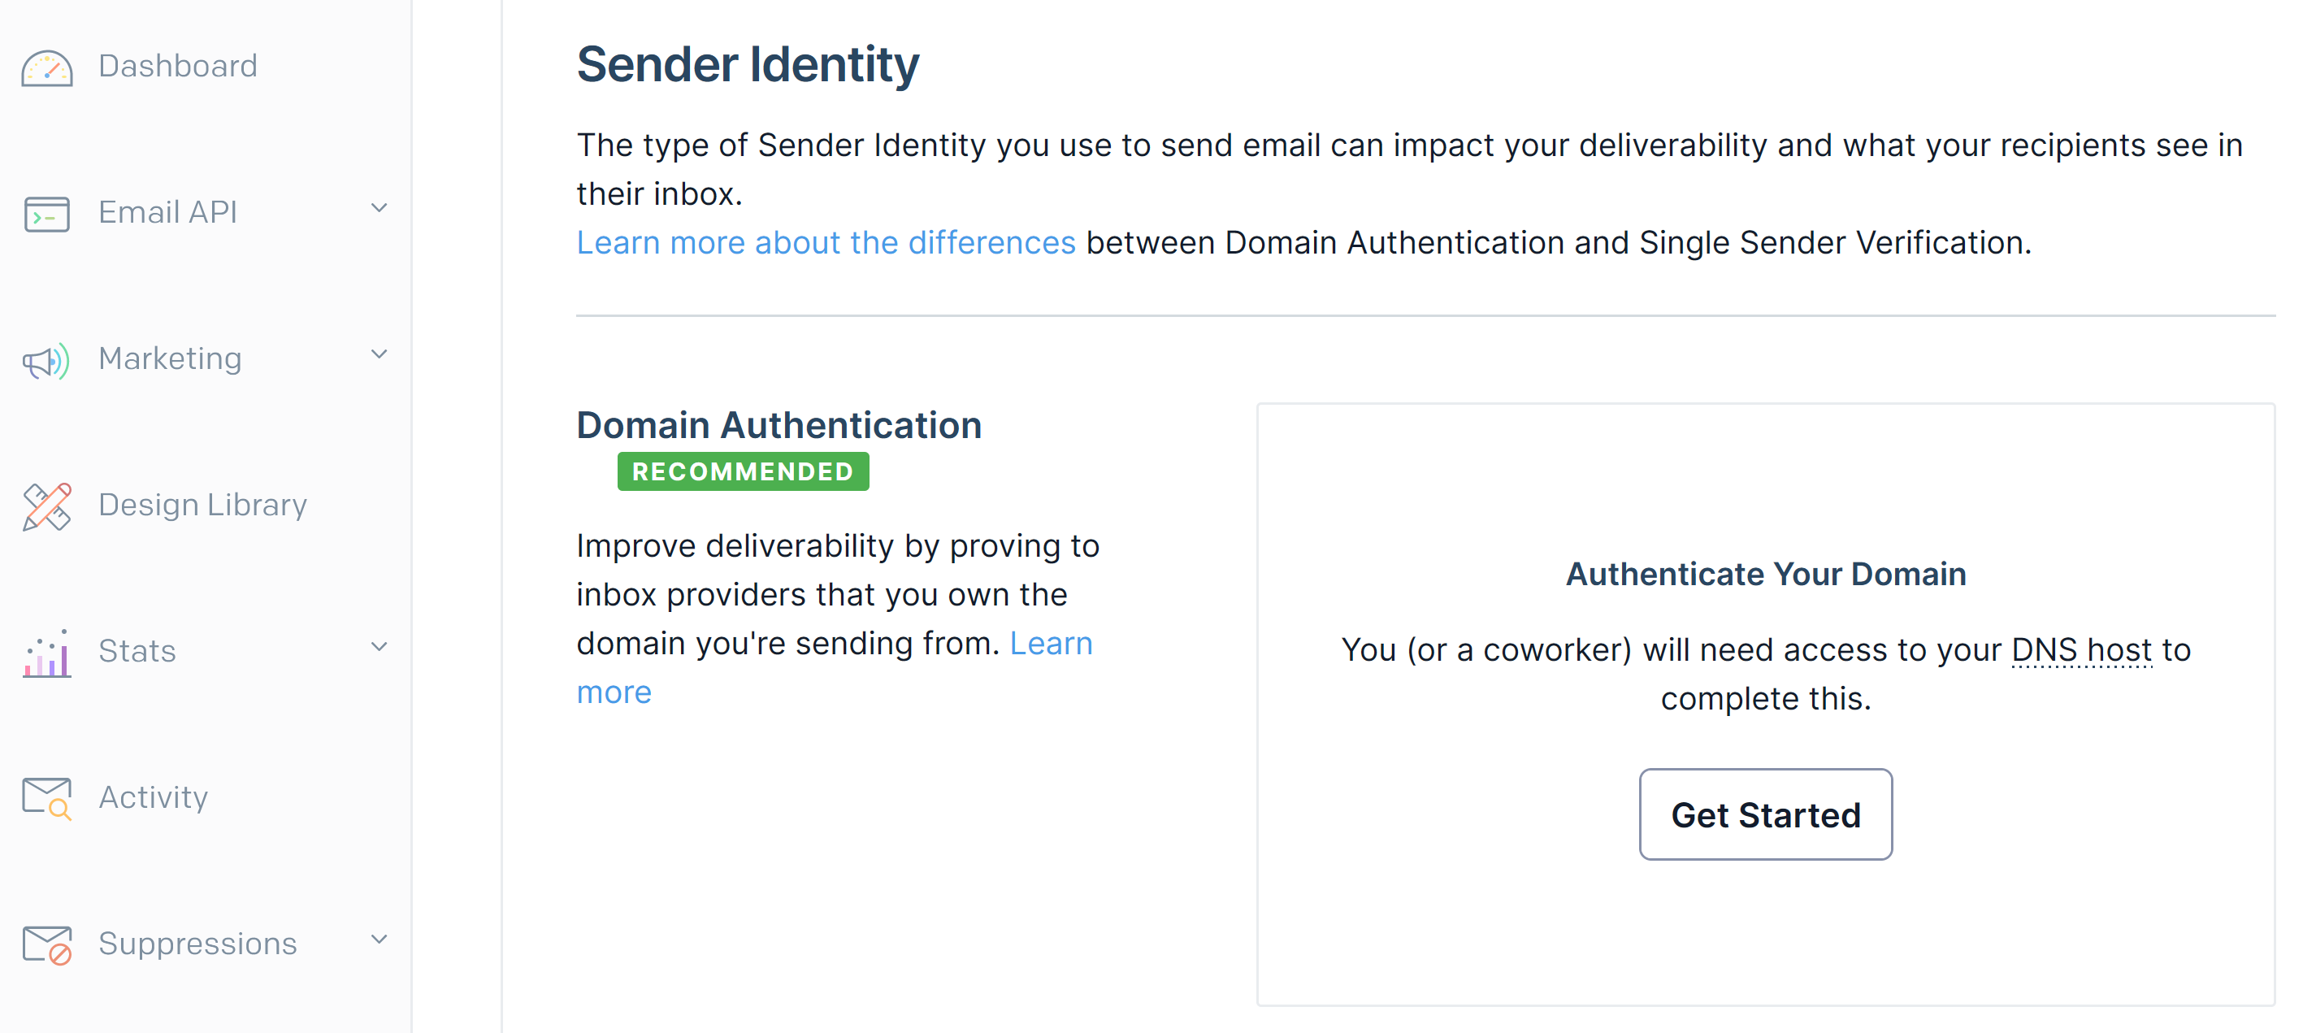
2. Authenticate Your Domain
https://app.sendgrid.com/settings/sender_auth

Slide 12
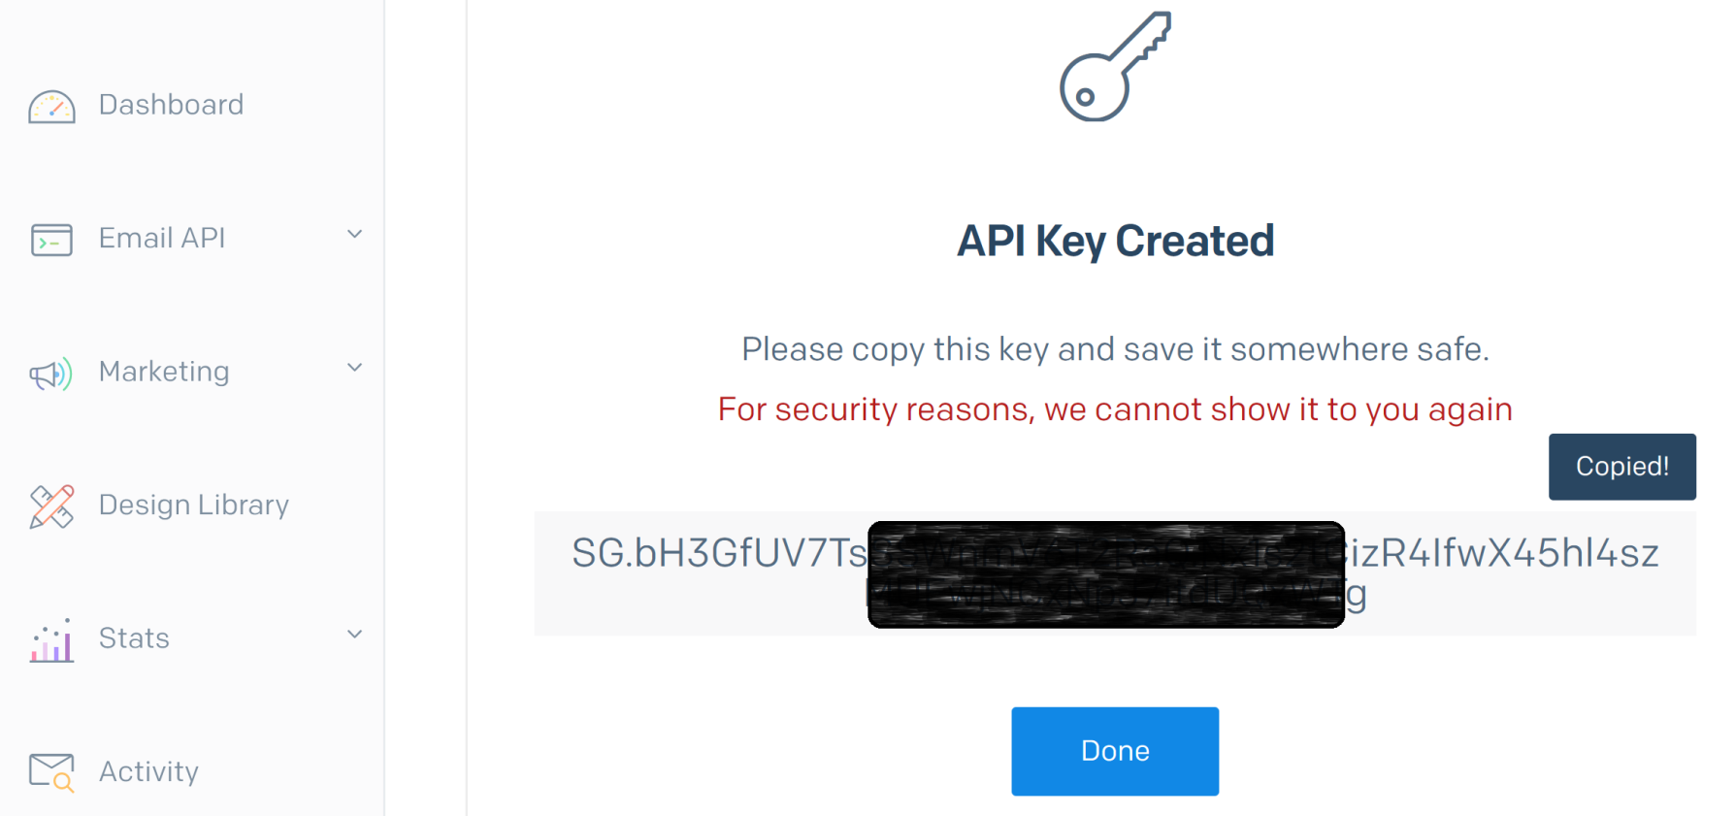
3. Create and Copy API Key
https://app.sendgrid.com/settings/api_keys

Slide 13
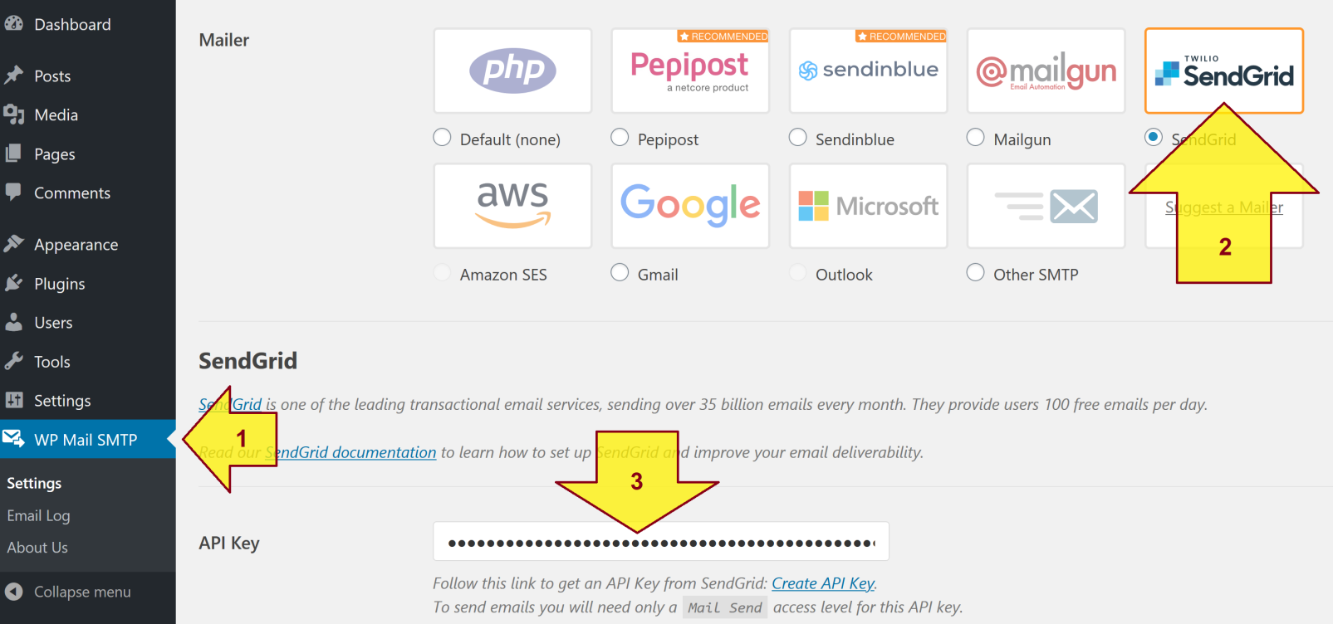
4. Install and Configure WP Mail SMTP

Slide 15
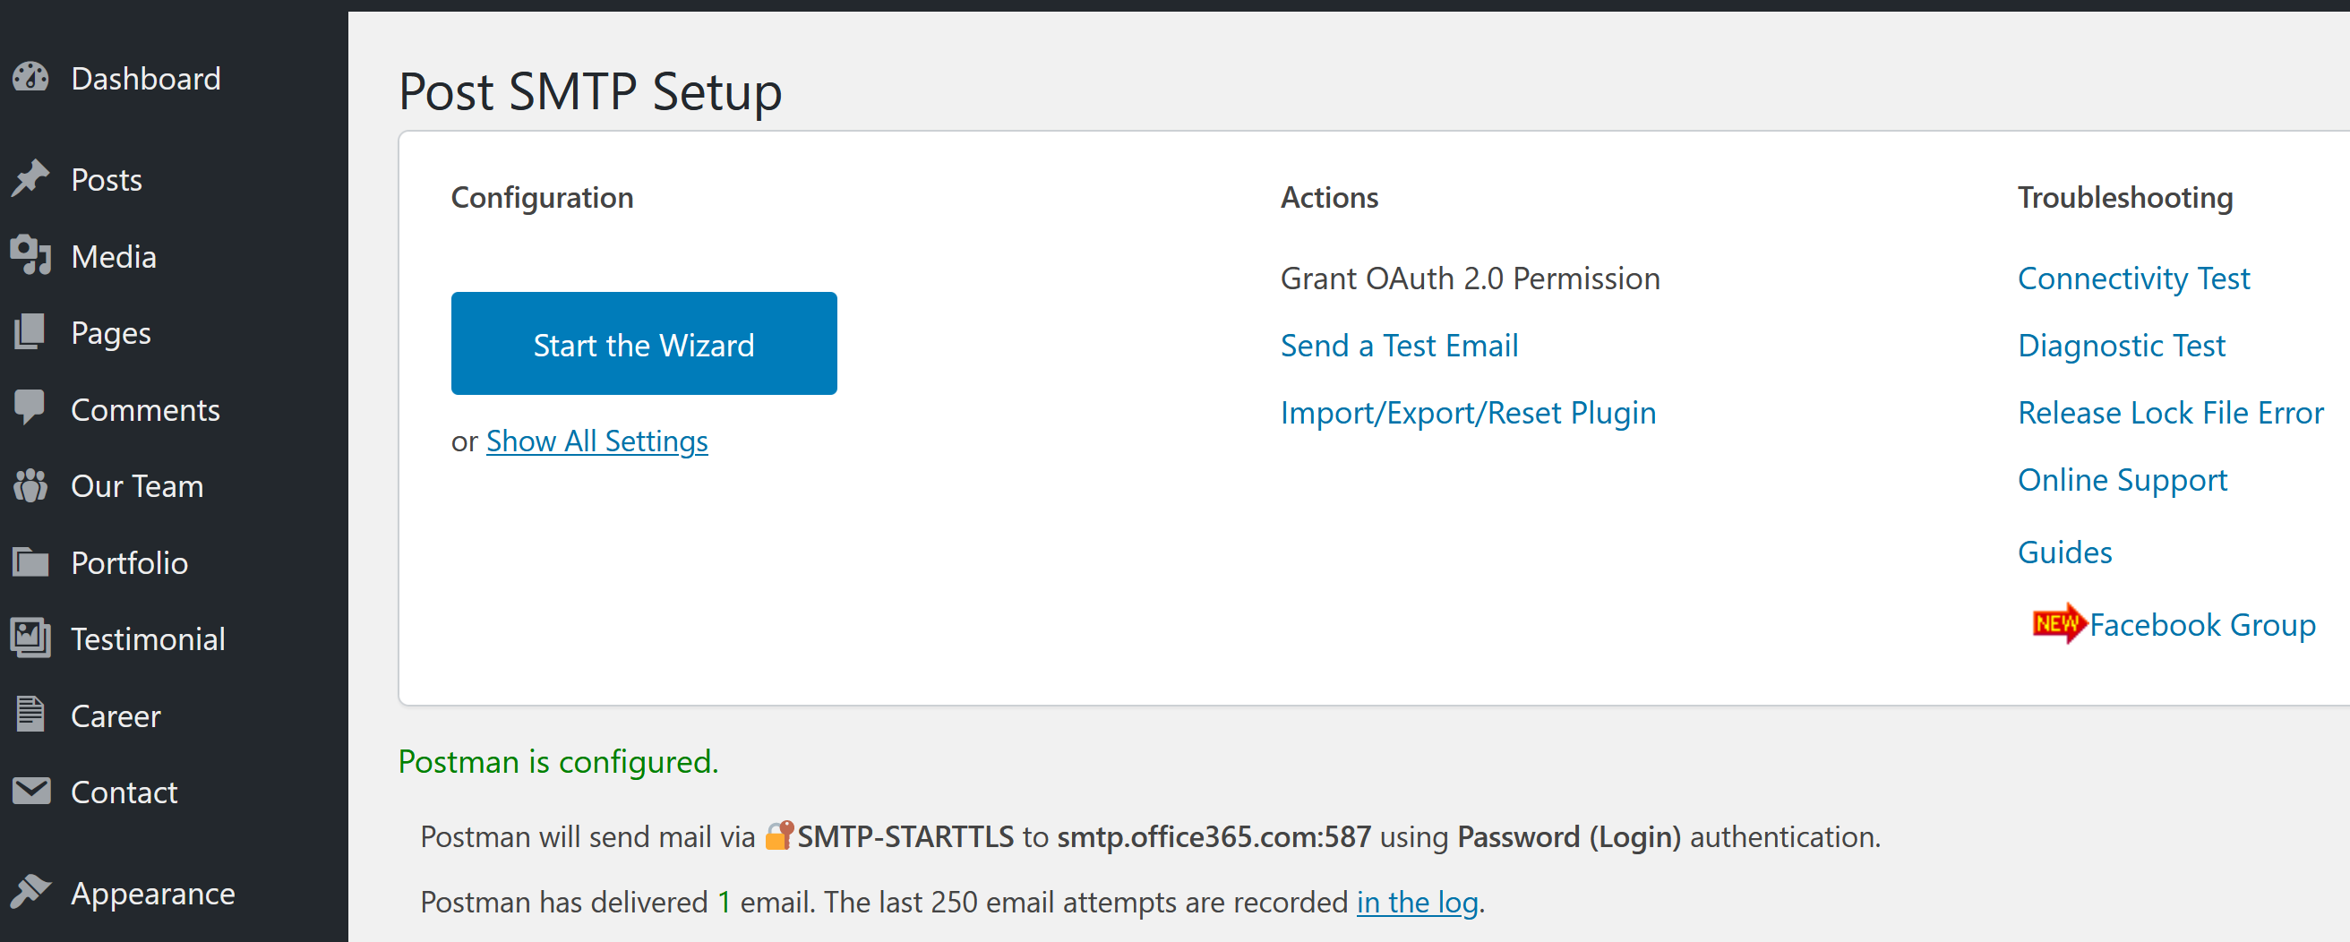
Post SMTP Plugin
https://wordpress.org/plugins/post-smtp/

Slide 16
Email Delivery
SendGrid offers “Send 100 emails/day free forever”.
If we need more than 100 emails per day then we may either
Purchase the service ( https://sendgrid.com/pricing/ ) or
Use an O365 account for delivery (MS is very strict in using an account for delivery. It is up to 1000 recipients per account. https://docs.microsoft.com/en-us/office365/servicedescriptions/exchange-online-service-description/exchange-online-limits ) or
Setup a private SMTP service and configure SPF, DMARC, DKIM (this takes implementation effort).

Slide 17
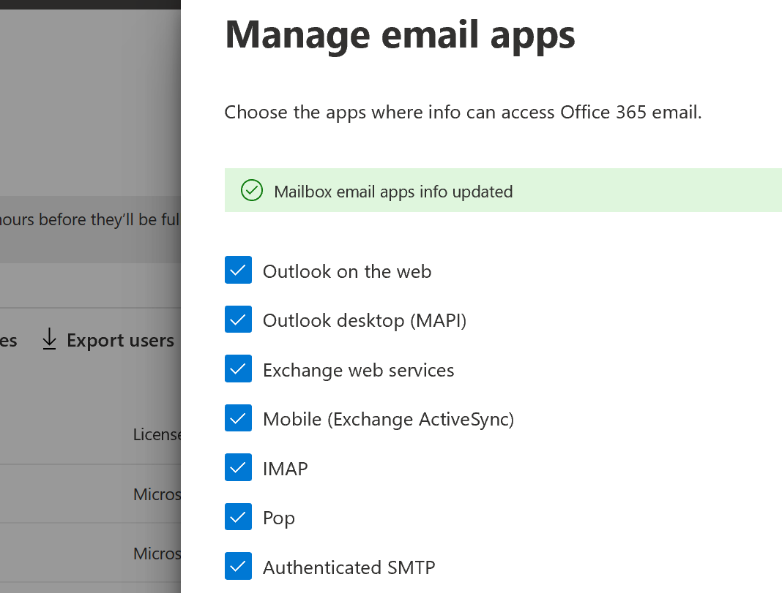
Settings for Office 365 (I)
Setup SPF
v=spf1 include:_spf.emfwd.name-services.com mx ip4:44.229.132.200 ip4:54.68.159.91 ?all
Enable Authenticated SMTP in Office 365 Admin Console.

Slide 18
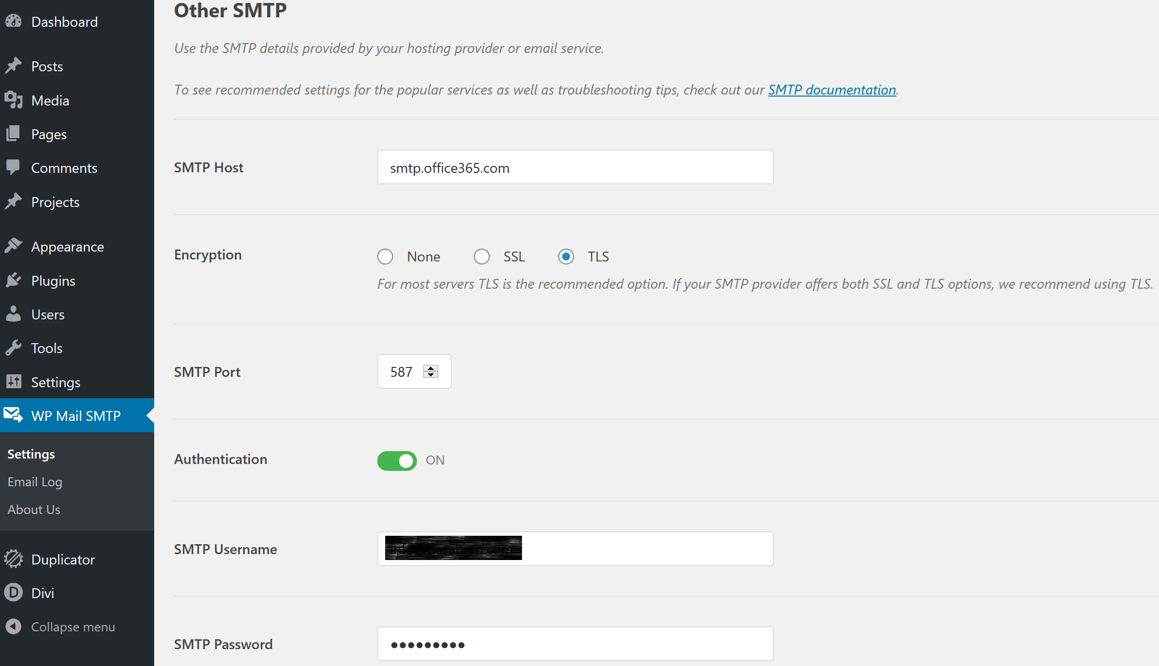
Settings for Office 365 (II)

Slide 19
Settings for Rackspace (I)
Configure DNS to send and receive email
https://support.rackspace.com/how-to/set-up-dns-records-for-cloud-office-email/
Setup SPF
v=spf1 include:emailsrvr.com mx ip4:44.229.132.200 ip4:54.68.159.91 ?all
Type | Hostname | Destination | Priority | TTL
MX | @ or left blank | mx1.emailsrvr.com | 10 | 3600 seconds or lowest allowed
MX | @ or left blank | mx2.emailsrvr.com | 20 | 3600 seconds or lowest allowed
TXT | @ or left blank | v=spf1 include:emailsrvr.com ~all | NA | 3600 seconds or lowest allowed
CNAME | autodiscover | autodiscover.emailsrvr.com | NA | 3600 seconds or lowest allowed

Slide 20
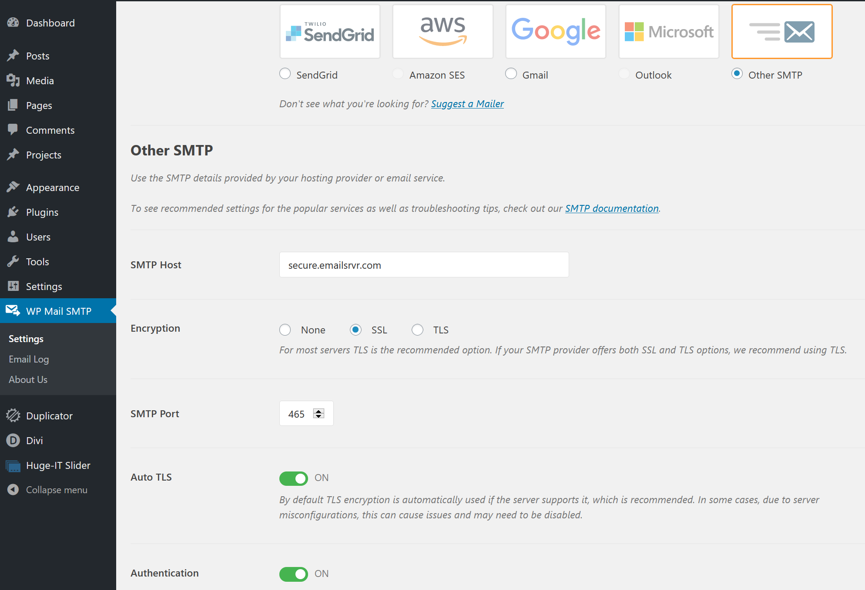
Settings for Rackspace (II)
https://support.rackspace.com/how-to/rackspace-email-and-hosted-exchange-settings/

Slide 21
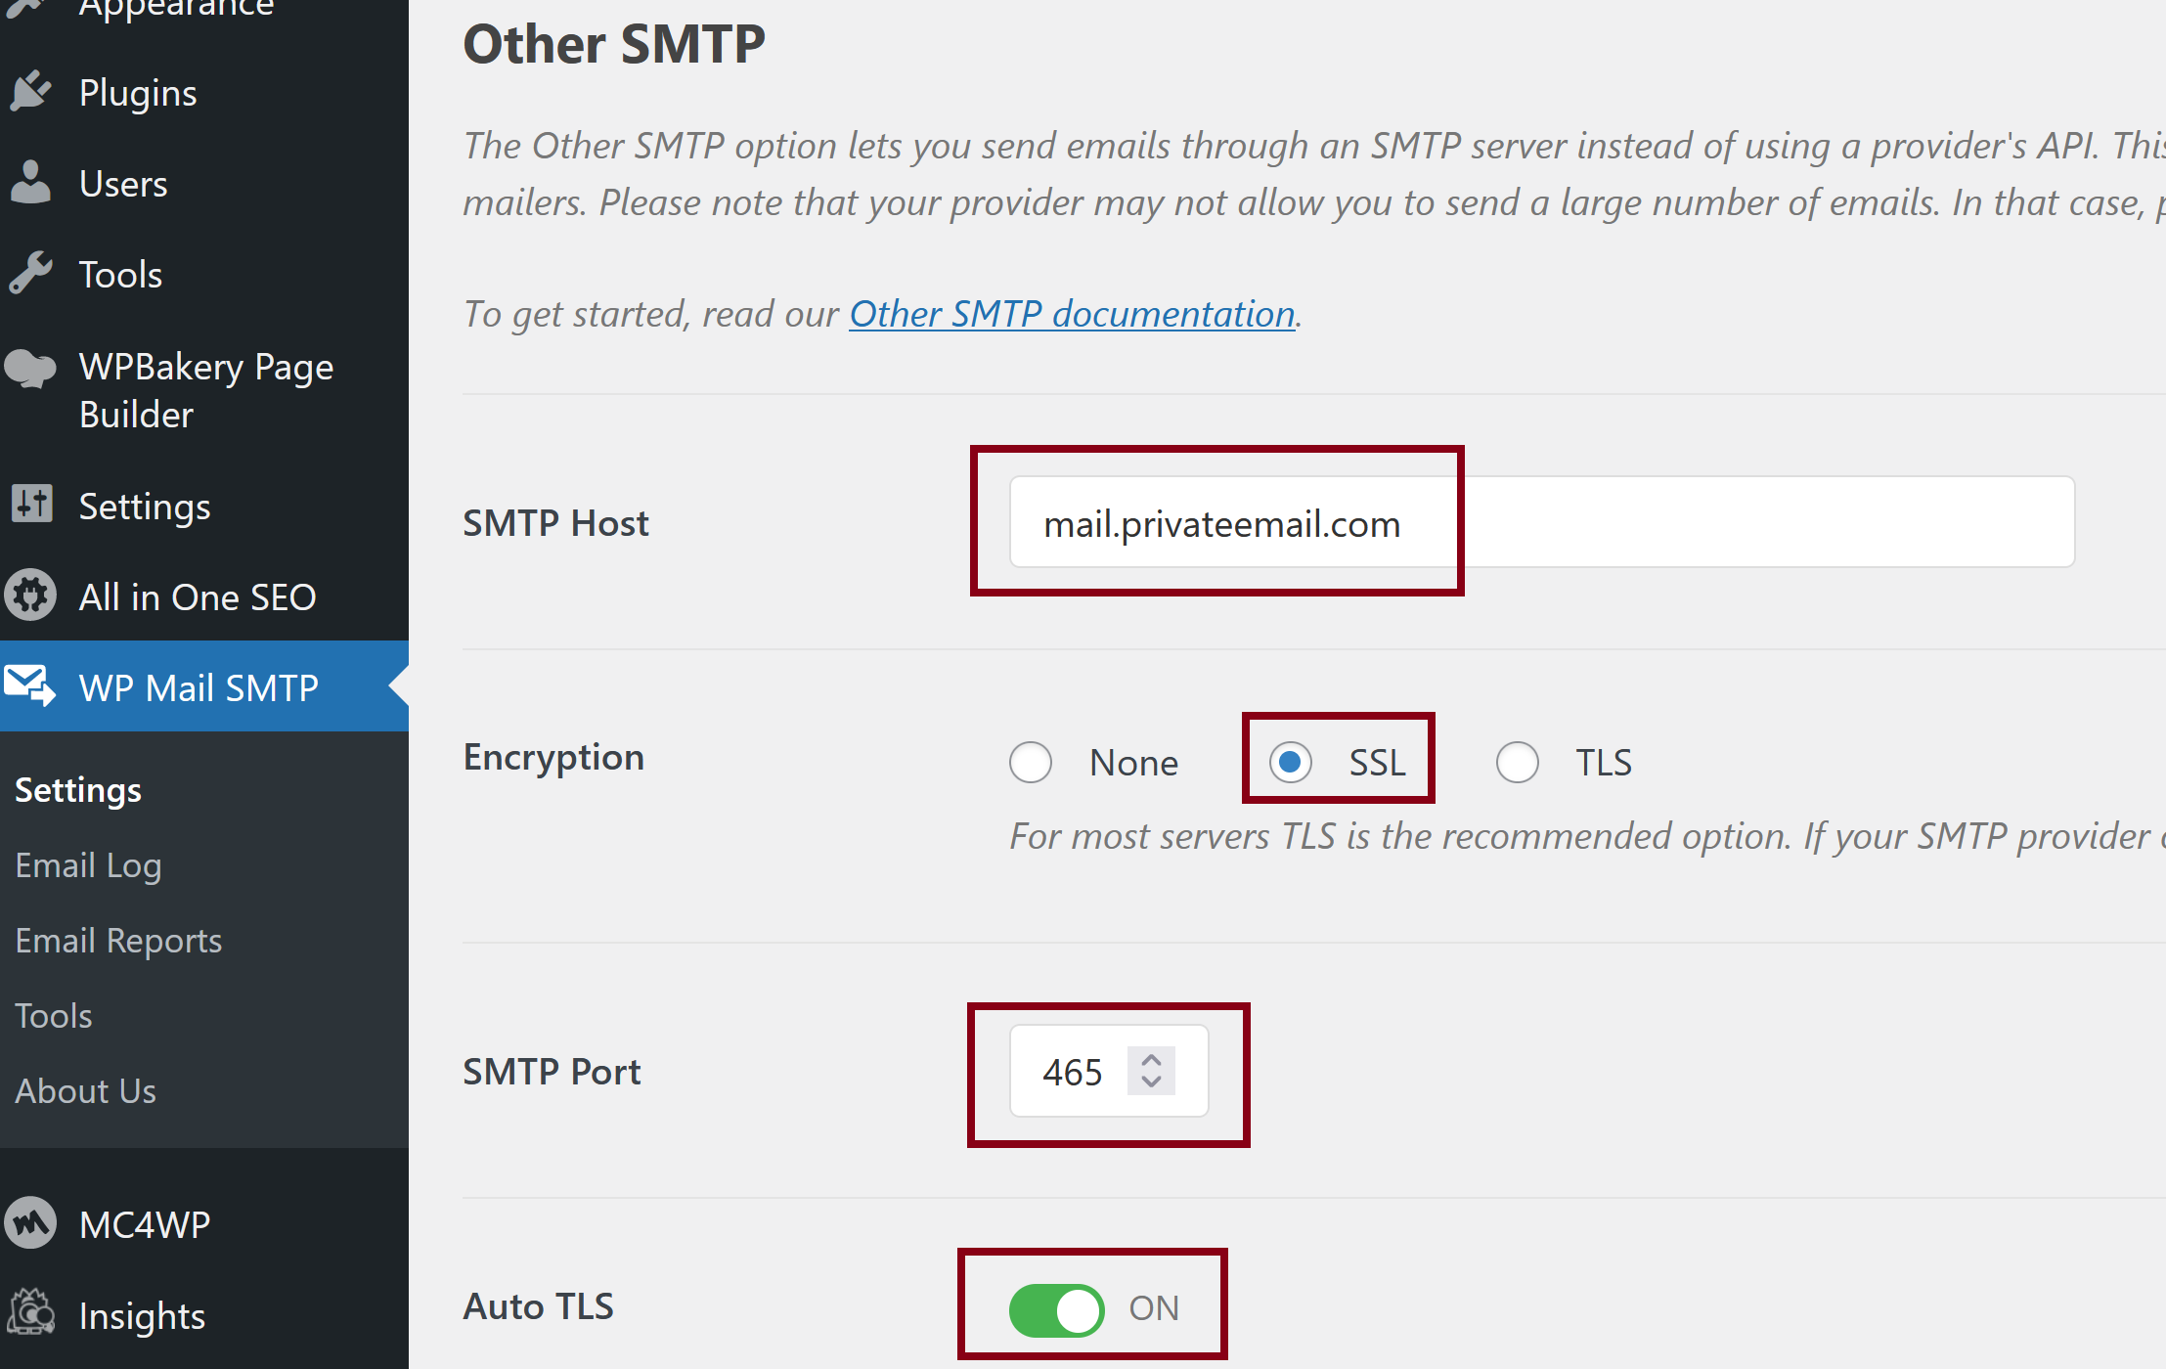
Settings for Private Mail
https://www.namecheap.com/support/knowledgebase/article.aspx/1179/2175/general-private-email-configuration-for-mail-clients-and-mobile-devices/

Slide 22
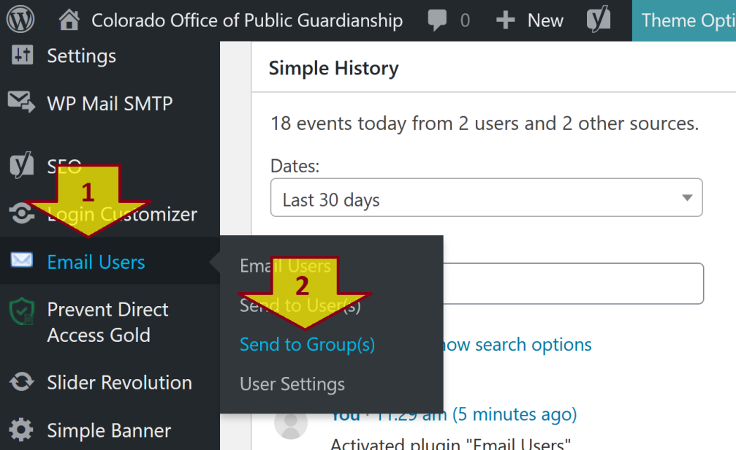
Email Users Plugin
https://wordpress.org/plugins/email-users/
Login as Administrator ( admin / ********** ).
Point mouse to the Email Users link on the left menu, click on the Send to Group(s) link.

Slide 23
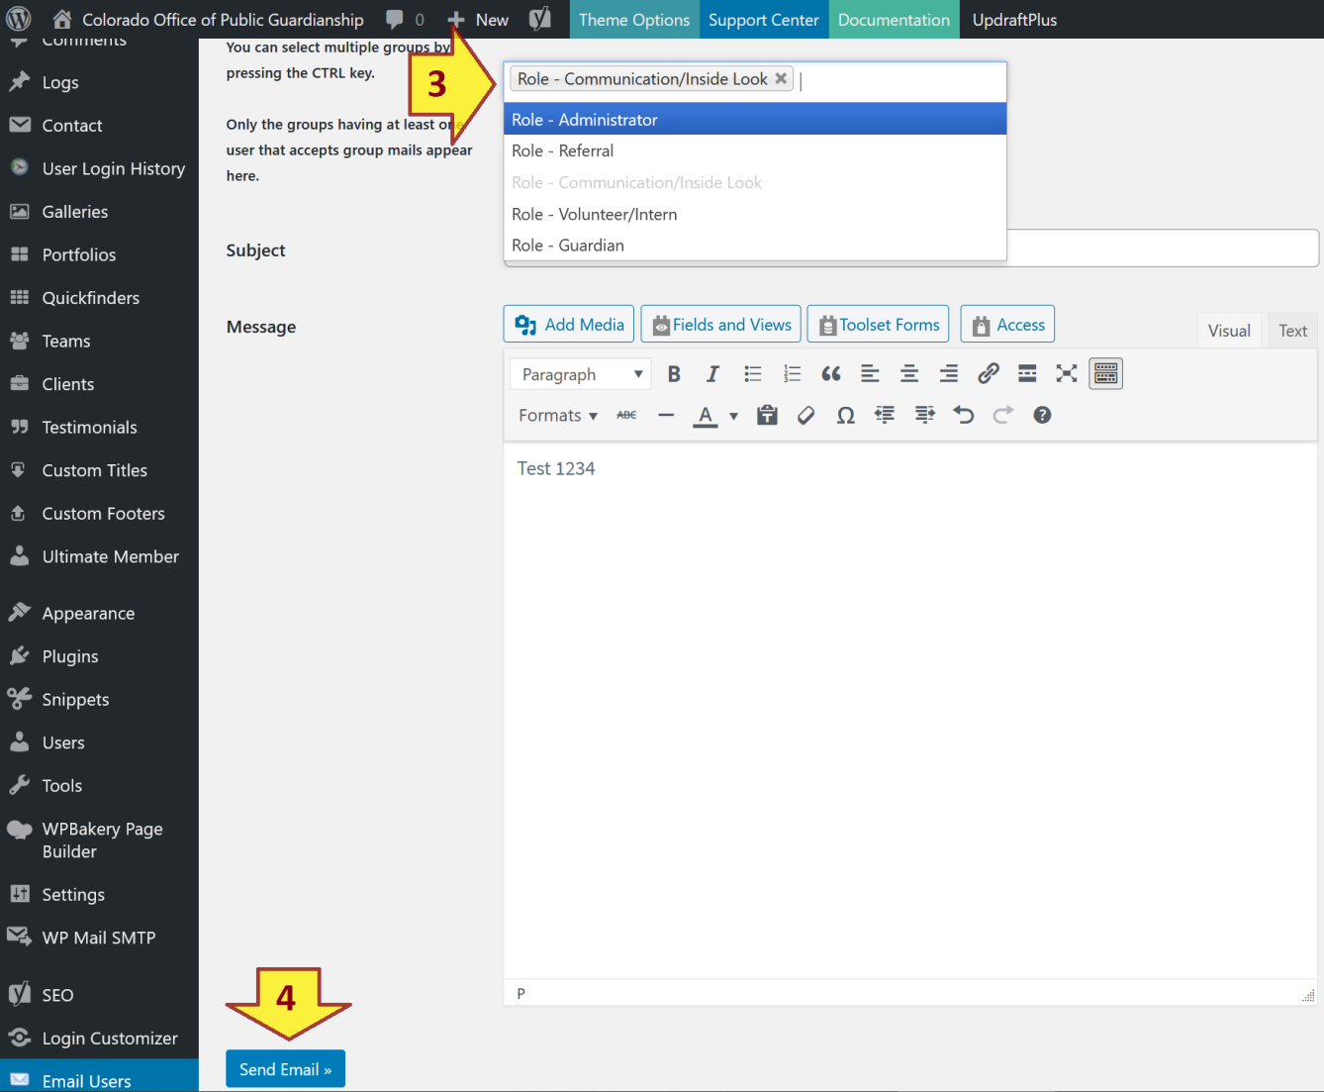
Email Users Plugin
Select one or some groups as recipients.
Compose an email and click the Send Email button.

Slide 24

Thank You & See You Again

